Slide 1

Generative AI for Virtual Interior Design
Revolutionizing Interior Design with AI

Slide 2

TEAM: TECH RIDERS
Sai Saket
Vamshi
Nikash
Rishikesh
Akash
Rishi
Nivas
Sathwik

Slide 3

Introduction:
Generative AI leverages algorithms to produce new content based on input data.
In interior design, it can create personalized spaces by analyzing user preferences and available furniture.
This technology addresses the growing demand for customized living and working environments.

Slide 4
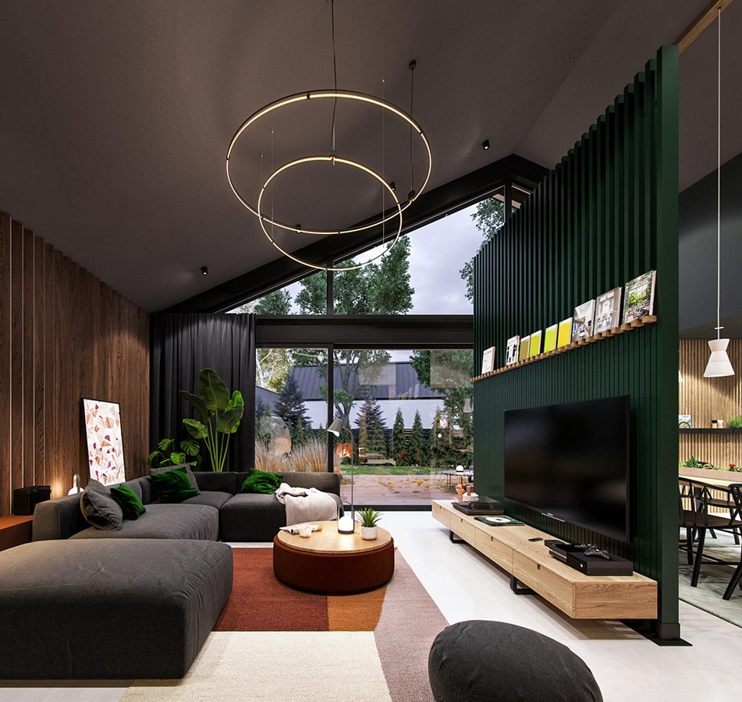
Objectives
Personalization: Tailor designs to individual user tastes and requirements.
Visualization: Provide realistic representations of interior spaces before physical changes are made.
Accessibility: Make interior design tools more user-friendly and available to a broader audience.

Slide 5

TECH/ USED
HTML, CSS, and JavaScript
These technologies work together to build dynamic web applications. HTML structures content, CSS styles it, and JavaScript adds interactivity
React.js
A JavaScript library for building user interfaces, especially single-page applications, using reusable components for better performance
Three.js
A JavaScript library that simplifies creating 3D graphics in web browsers, enabling interactive environments with realistic effects
Python (CGAN Modeling)
A programming language used for data analysis and AI, helping optimize furniture placement by analyzing user inputs and space constraints.

Slide 6

Generative Approaches
User-Centric Design Algorithms:
Implement advanced AI models that learn from user input (e.g., style preferences, space constraints) to generate personalized designs. Use reinforcement learning to continuously refine suggestions based on user feedback.
Enhanced 3D Visualization Techniques:
Leverage AI-powered rendering software to generate photorealistic 3D models quickly. Use augmented reality (AR) for users to virtually "place" furniture in their real space through their devices, enhancing immersion.

Slide 7

3-D modelling
Three.js Integration:
Leverage Three.js, a powerful JavaScript library, to create and render 3D models directly in the browser. This allows users to view and interact with detailed, real-time 3D representations of their interior designs.
Customizable User Experience:
Users can specify room dimensions, furniture placement, and decor preferences, and Three.js dynamically generates a 3D model based on their inputs.
Realistic Visualization:
Using advanced rendering features like lighting, shadows, and textures, Three.js produces photorealistic models that closely resemble the real-world design.
Interactive Features:
Users can rotate, zoom, and explore the 3D models to visualize every angle of their space, providing a fully immersive experience.

Slide 8
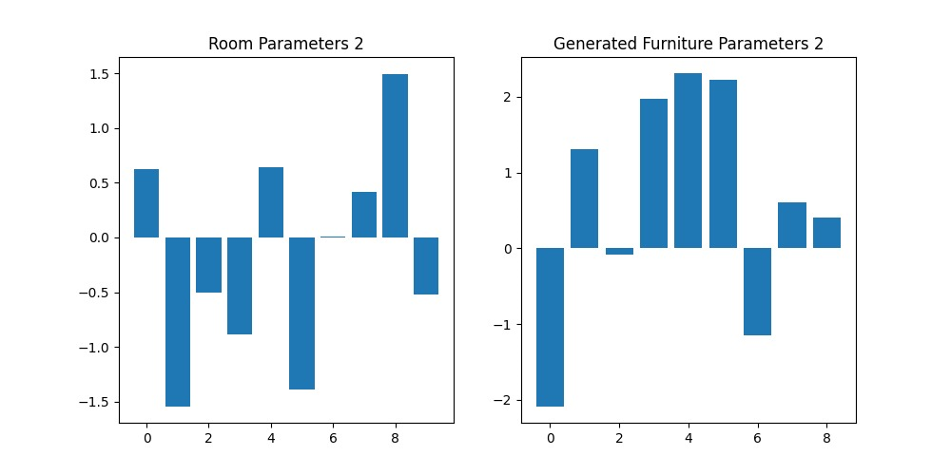
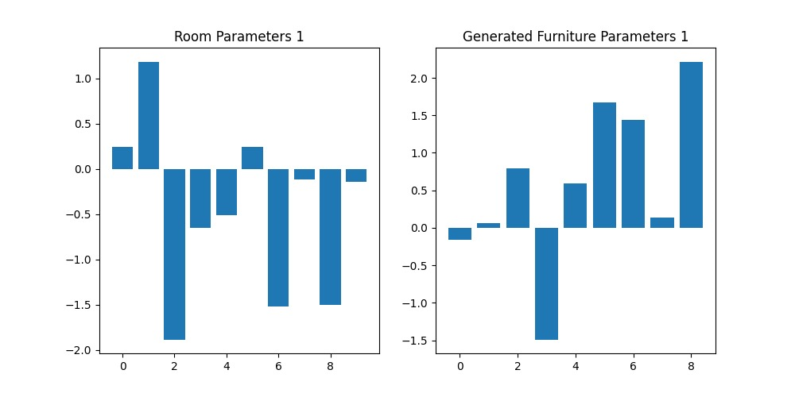
Results

Slide 9
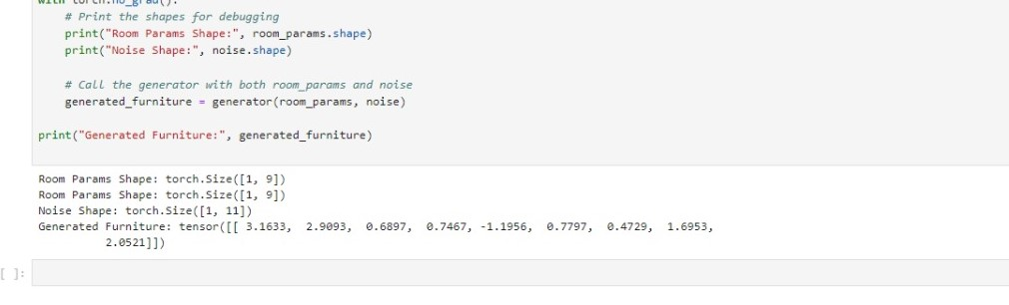
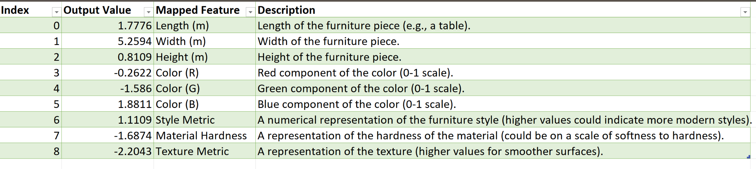

Slide 10
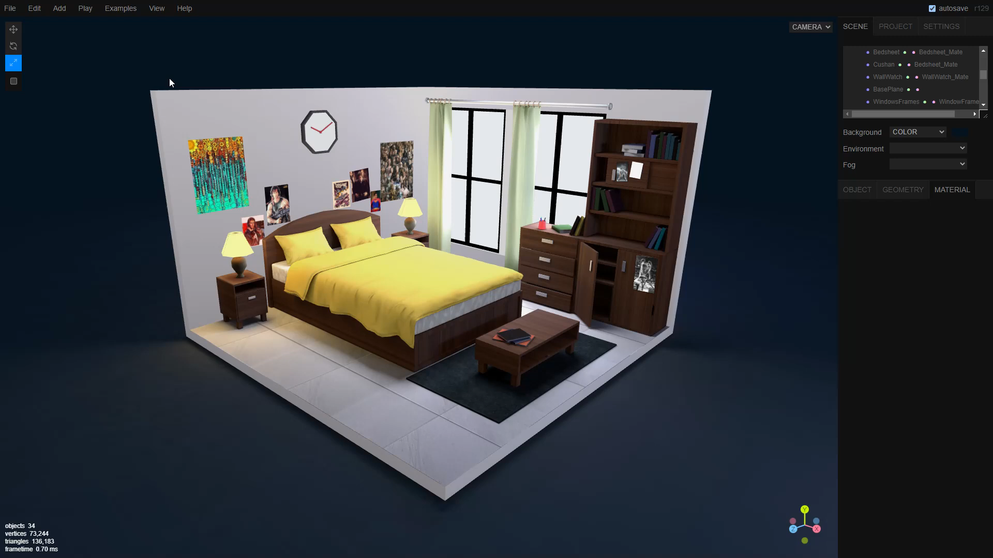

Slide 11

Conclusion
Exceptional 3D Experience:
Our application delivers an immersive 3D experience that transforms the way users visualize their interior designs, making it engaging and interactive.
Generative Approaches: Tailored design solutions that adapt to user preferences and spatial constraints.
3D Modeling with Three.js: Real-time rendering of customizable room layouts, providing realistic visualizations.
Optimized Furniture Placement: Utilizing Gyan modeling to ensure furniture is arranged favorably, maximizing space and enhancing usability.
Empowering Users:
By combining cutting-edge technology with user-centered design, we empower individuals to create personalized interiors that reflect their unique styles and preferences, revolutionizing the interior design process.

Slide 12


